Slide 1
Version Control

Slide 2


How to write a book?!!!
Develop a writer’s mindset
Create a book writing space
Determine your book's topic
Create a book outline
DevOps 101 .
Finish writing your manuscript
Edit your book
Choose a compelling book cover
Format your book
Prepare to launch your book
Publish your book

Slide 3
How to write a book?!!!
There are some new methods we want to add
There are some typo in the book
…
DevOps 101 .
DevOps 101 .
Revision 1
Revision 2

Slide 4


How to write a book?!!!
How to split the work?
How to connect all parts?
How to track changes?
How to get it to be a smooth read?
How to know who write which part?
DevOps 101 .
How to avoid conflicts?
How to find any conflicts?
How to find the parts which need improvement?

Slide 5
What is version control?
Book
Software Development
Develop a writer’s mindset
Understand the problem you are trying to solve
Create a book writing space
Create a code writing space
Create a code writing space
Determine your book's topic
Design a solution
Create a book outline
Draw a flowchart
Finish writing your manuscript
Write pseudo-code
Edit your book
Write code
Choose a compelling book cover
Test
Format your book
Debug
Prepare to launch your book
Test with real-world users
Publish your book
Publish your code

Slide 6



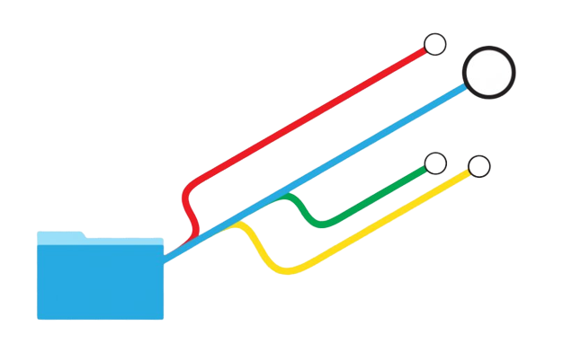

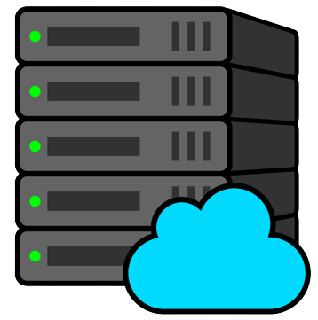

What is version control?
This resolve all the question that we asked 2 slide ago :)
Notes:
also known as revision control, source control, or source code management (SCM), version control system (VCS)

Slide 7
What version control provide?
Single source of truth
Team collaboration
Keep all the code history
Track every change
Which part
By whom
When
Resolve conflicts
Central location fo code
Rollback capability
Comparison capability
Code review

Slide 8
Types of version control
Distributed (DVCS)
Access repositories from multiple locations remotely
Centralized (CVCS)
Working with the same central repository
Lock-based
Uses file locking to manage concurrent access to files and resources
Optimistic
Every user has their own private workspace, when wanted, submit a request, server determines which one can be safely merged
Notes:
Distributed
A distributed version control system (DVCS) allows users to access a repository from multiple locations. DVCSs are often used by developers who need to work on projects from multiple computers or who need to collaborate with other developers remotely.
Centralized
A centralized version control system (CVCS) is a type of VCS where all users are working with the same central repository. This central repository can be located on a server or on a developer's local machine. Centralized version control systems are typically used in software development projects where a team of developers needs to share code and track changes.
Lock-based
A lock-based version control system uses file locking to manage concurrent access to files and resources. File locking prevents two or more users from making conflicting changes to the same file or resource.
Optimistic
In an optimistic version control system, every user has their own private workspace. When they want to share their changes with the rest of the team, they submit a request to the server. The server then looks at all the changes and determines which ones can be safely merged together.

Slide 9



Git

Slide 10
What is Git
An open source distributed version control system
Enables software development teams to have multiple local copies of the project's codebase independent of each other
These copies, can be created, merged, and deleted quickly

Slide 11
Git States
Git has three file states: modified, staged, and committed
A modified file has been changed but isn't committed to the database yet.
A staged file is set to go into the next commit.
When a file is committed, the data has been stored in the database.

Slide 12
Git Repository
A repository in Git is a storage for files, which can be remote or local.
Remote Repository is a repository where the source code is placed on a server on the Internet and can be shared by everyone.
Local repository is a repository where the source code is located on your computer and only you can make changes.
To fully understand the git, you MUST read this document.

